Slide 1


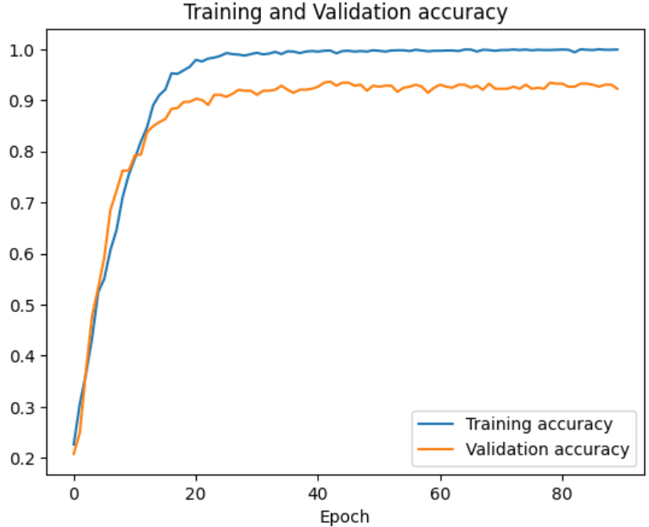
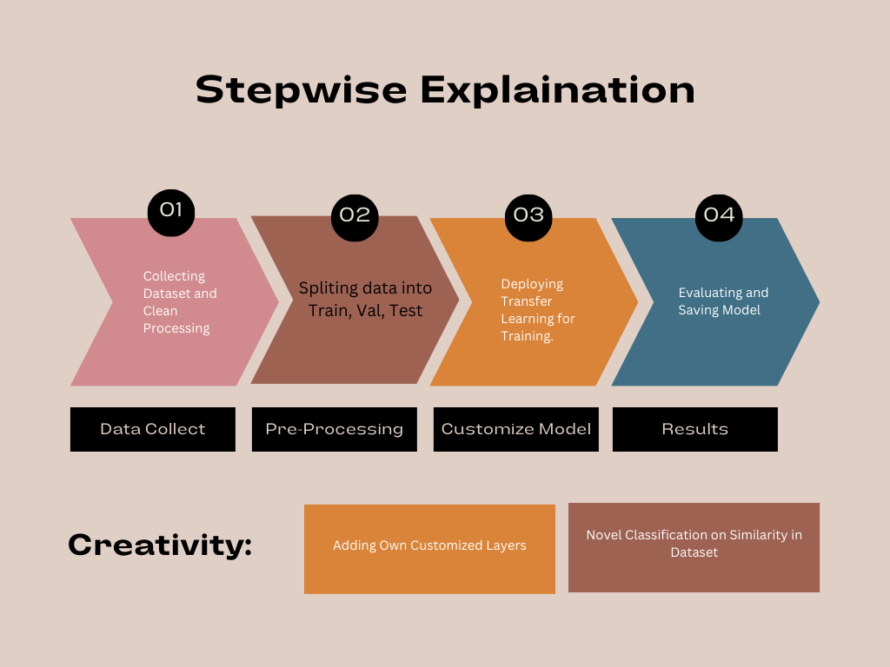
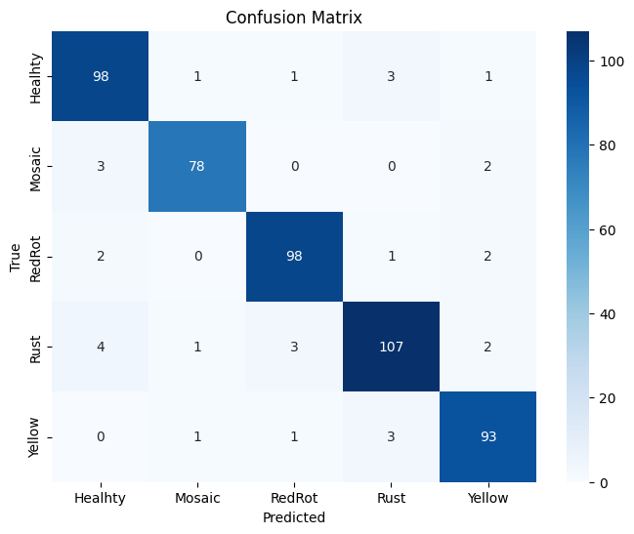

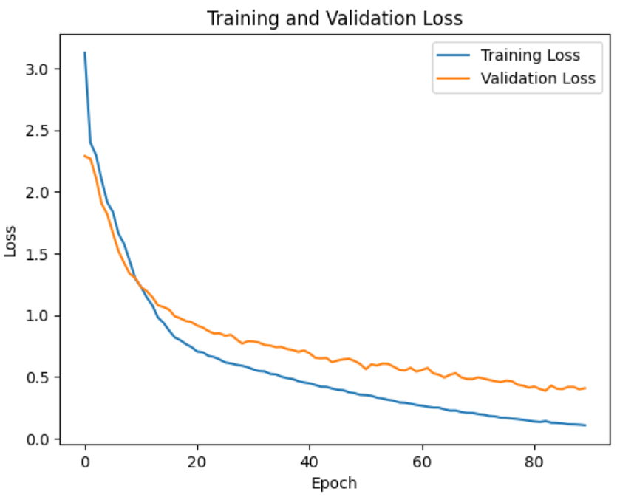

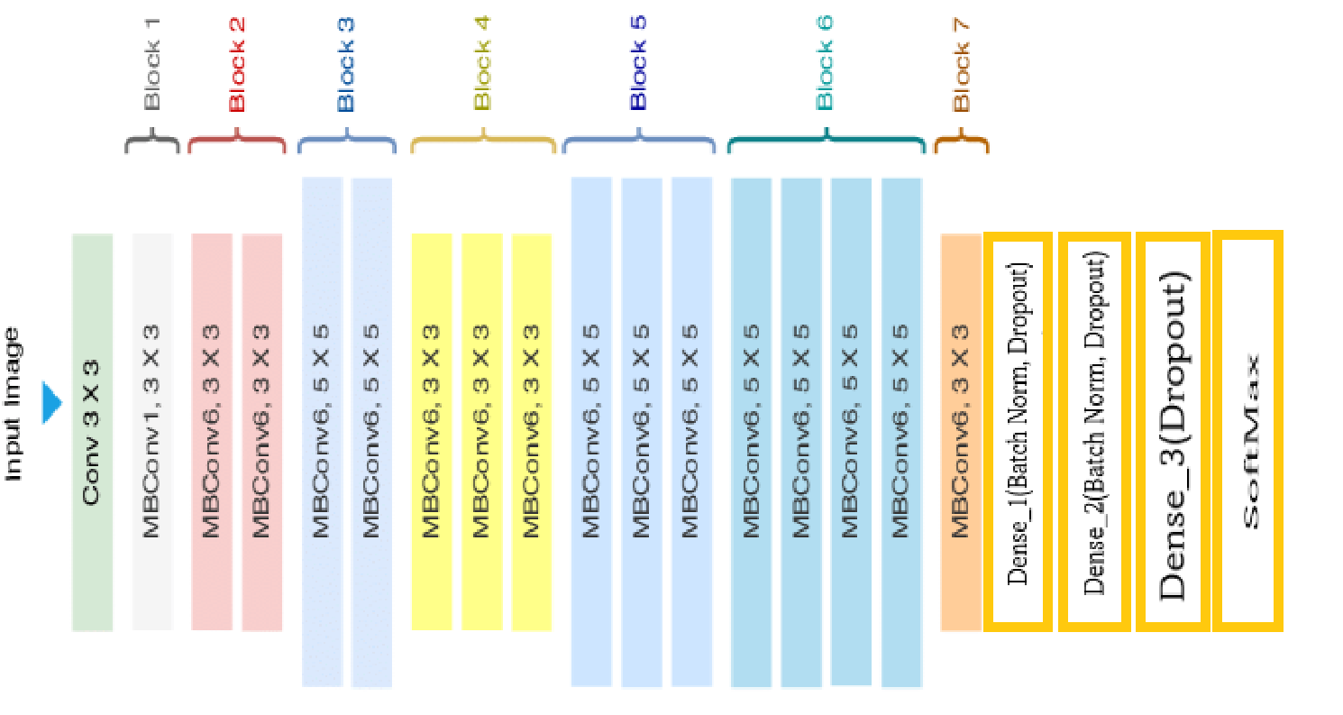
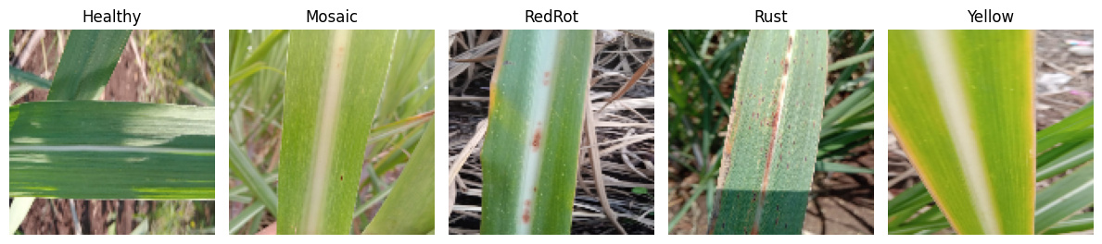

AI Harvest: Empowering Sugarcane Health with Deep Learning Disease Classification!
MOTIVATION
METHODOLOGY
EXPERIMENTAL RESULTS
Many of times farmers have a hard time to track the status of their overall yield thus making it harder for them to file and track claims for their farms with insurance companies. We wanted to design a program which would help farmers file and track their claims faster and easier with the help of our sugarcane leaf disease detection program.
Data was visualized using matplotlib, seaborn, OpenCV, and NumPy. TensorFlow and scikit-learn were employed for model creation, with data split using split-folders. Model utilized an EfficientNet-Bo base with stacked dense layers, with frozen weights for faster training. Optimized with RMSprop, Early Stopping was implemented to conserve resources. Dropout layers, L1 kernel regularizer , and Batch Normalization enhanced model robustness and efficiency.
The model was trained on an Efficient-Net and our novel Customized Dense Layer CNN architecture. We named our model “CaneGuard’. To overcome the problem of overfitting and we made the model more robust and generalized techniques such as Batch Normalization, Kernel Regularization and Dropouts were used. The model was trained and compared with other CNN architectures like VGG-16, VGG-19 and a basic CNN model.
DATASET DETAILS
Manually collected image dataset of sugarcane leaf disease. It has mainly five categories in it. Healthy, Mosaic, RedRot, Rust and Yellow disease. The dataset has been captured with smart phones of various configuration to maintain the diversity. It contains total 2569 images including all categories. This database has been collected in Maharashtra, India. The database is balanced and contains good variety. The image sizes are not constant as it originates form various capturing devices. All images are in RGB format. Click Here To Visit the Dataset Page
Comparative analysis of the proposed model with other CNN models (84 epochs)
Model | Validation Accuracy
EFFICIENT NET-B0 | 93.86%
VGG-16 | 78.19%
VGG-19 | 72.34%
BASIC CNN MODEL | 72.46%
Classes | Healthy | Mosaic | RedRot | Rust | Yellow
Images | 522 | 462 | 518 | 514 | 505
{Cane Guard with batch normalization}
Accuracy: 0.9386138613861386 Precision: 0.9388793105905113 Recall: 0.9386138613861386
F1-score: 0.9386298436306962
DETAILS:
Name: Siddharth Sharma, Divyan Tiwari
Enrollment No.:A023119822013, A023119822018
Department: B. Tech.(AI)
Institute: Amity University Uttar Pradesh(Noida Campus)
Email ID: siddharth..sharma8@s.amity.edu, divyan.tiwari@s.amity.edu
CaneGuard Model’s Architecture
E3G-12B, Amity University, Sector 125, Noida, UP. Email: ai@amity.edu www.amity.edu/acai/

